Slide 1
Predicting the Sales for an online based organisation

Slide 2
Problem Statement :
Predict the overall sales, for different courses

Slide 3
Overview (Layout of the Presentation)
Features
Individual Feature Behaviour
Feature Behaviour based on Sales
Features selected after analysis
New Features
Approach to reach at better judgement of sales.

Slide 4
Features ( Total – 10)
Id – Identifies each row uniquely
Day_No – Number of days about tracking of sales
Course_ID – Unique ID for course.
Course_Domain – Domains in Courses
Course_Type – What type of course is it?
Short_Promotion – Was the promotion for a particular course done for short time?

Slide 5
Features ( Total – 10)
Long_Promotion – Did the course have long promotion?
Public_Holiday – Did a particular had public holiday ?
User_Traffic – No of users on particular course page
Competition_metric – Metric value defining the competition
Sales – Total course Sales
Important - In testing data , user_traffic feature was not given , as one cannot predict users before hand

Slide 6
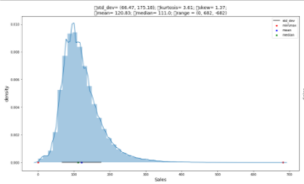
Summary of features (Univariate Analysis)
ID – 512087 out of 512087 unique id’s for every sale. (No duplicate ID’s , telling no same user subscribed a unique course more than once before the course ends)
Sales – Sales per day were for range ( 0 , 800)
(0 Sales means – No sales were done a particular day) Majority sales per day were from (50 , 250)

Slide 7
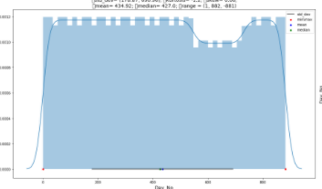
Day_No – Records for 882 days , each day with multiple courses sales.
Range – {1,882}
(Overall pattern was constant )
but a major dip in sales for days between 500 – 700
And a small dip in sales after every short interval , possibly a weekend.
Course_No – Unique 600 ids for every course
No Special pattern seen.

Slide 8
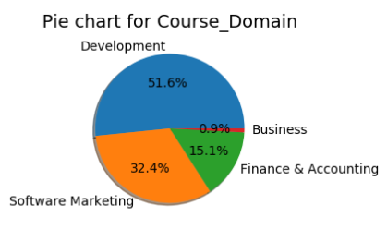
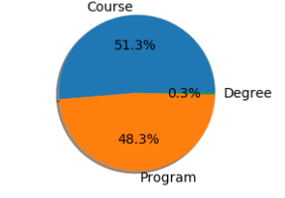
Course_Domain – Total 4 domains
Development – Maximum Courses (more than 50 %)
Software Marketing – (32 %)
Finance and Accounting – (15%)
Buisness – (1%)
Course_Type – 3 types of course
Course – Most courses (more than 50 %)
Program – (48%)
Degree – (0.3%)
Degree > Program > Course – Time duration

Slide 9
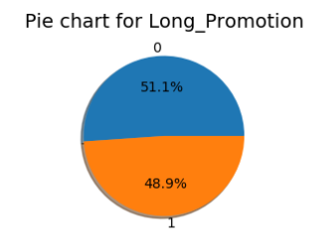
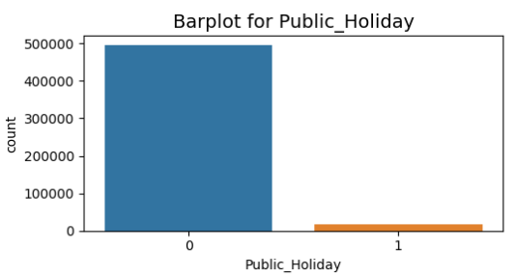
Short_Promotion– Values – {0 , 1} , wethere or not on promotion
About 38 percent courses were on short_promotion
Long_promotion – values – {0,1}
Almost half the courses were on long promotion
51 % on no long_promotion , 48.9 on promotion
Public_Holiday –Values – {0,1}
Only 3% holidays overall

Slide 10
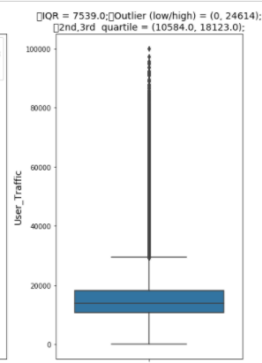
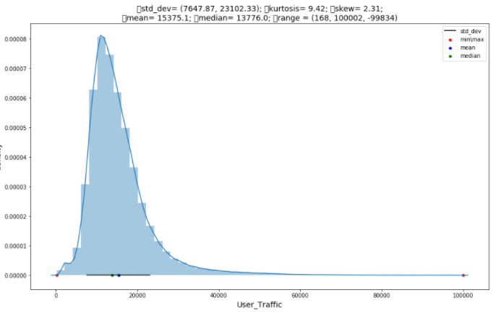
User_Traffic – Range – (168 , 100000)
Minimum 168 users visited the course
Average users visiting were 15375
Right skewed graph , mean – 15375
Had some outliers (Some very high Values which affect the numbers drastically)
After removing Outliers , mean users – 14154
Competiton_metric – Range – (0.0 – 0.8)
It is a kind of a competition score so given out of 1.0
Average score values – (0.01 – 0.09)
Right skewed graph , Mean score – 0.07
1762 null values – 0.03 %
Outliers

Slide 11
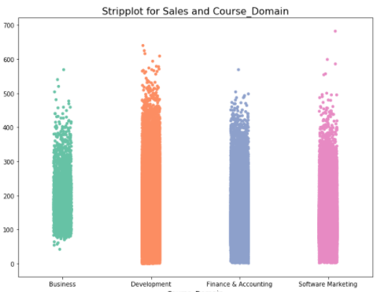
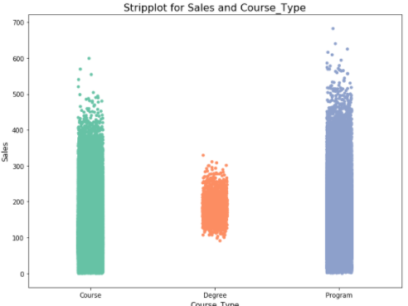
Summary of features wrt Sales (Bivariate Analysis)
Course_Domain –
Sales are inverse for the amount of courses in each domain.
Buisness > Development > Finance > software (Sales pattern)
For a single day , except business , minimum sales were 0
Minimum sales were approx. 70 for business domian
(Business had least number of courses in number)
Course_Type –
Degree > Program > Course (Sales pattern)
Every course_type had 0 sales as minimum value
Except for Degree course type
90 minimum sales
Least courses from this type
P.S. -- (Rechecked results with T , Z tests when necessary)

Slide 12
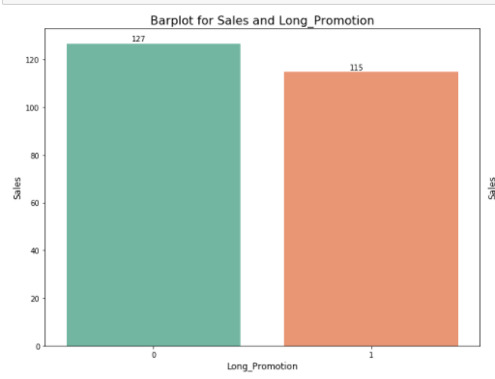
Short_Promotion –
Short_promoted had better sales
Long_Promotion –
Long_promoted Courses did not do better in sales
Public_Holiday –
Sales were more on Regular days
0
1
Long_Promotion

Slide 13
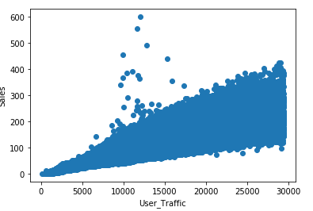
User_Traffic– Changes linearly in positive direction with change in sales
(If user_traffic increase by 10, we can be certain for sales to increase with a value, and is checked with Correlation value)
Correlation Value – Range (-1,1) Correlation value – 0.8
Course_ID , Day_No and Competition_Metric --
Did not have pattern to visualize or to generalize results.
Correlation – 0.1

Slide 14
Features considered after analysis
Continuous Features
User_Traffic
Course_ID
Categorical Feature
Course_Domain
Course_Type
Short_Promotion
Long_Promotion
Public_Holiday

Slide 15
Feature engineering (Made some new features from existing to understand data better)
From our dataset extracted below mentioned features(6 features)
Day_No – This was already given starting from 1st till 882th day records.
Date – Assumed 0th day as 31 December 2017
And extracted Dates by adding Day_No , so 1 ^{st} day as 1 Jan 2017
And 882th as 31 march 2020
Year , Month – Since we have Dates now
Extracted respective year and months from dates.
Day – extracted day number of respective month
Some months had maximum of 31 day value, whereas a specific month had only 28 as maximum day value.

Slide 16
Feature engineering
WeekNumber – Since a year have 52/53 weeks
Extracted which week does the particular Day_No falls in.
Helped in understanding Public_Holiday
DayName – What day is it? Monday – Sunday?
Was extracted since we have months now.

Slide 17
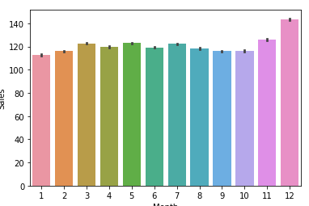
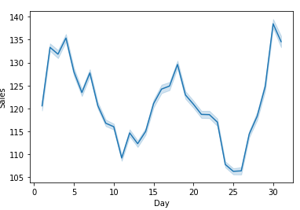
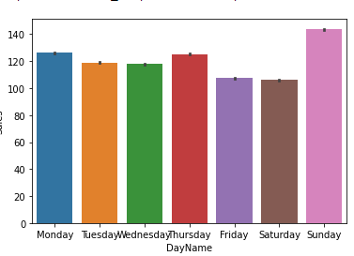
Analysis For new Features.
Year – Sales are increasing with Year
Month – Sales increased with growing months , specially a peak in last two months
Also verified the same trend through WeekNumber variable , highest sales in week 48-51
Day - Start and end of month usually had more sales.
DayofWeek – Few days had more sales in general.
Weekend(Sunday) ,
Start(Monday)
mid (wed) of week

Slide 18
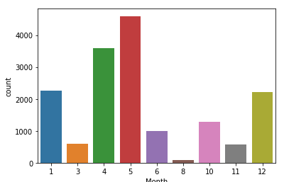
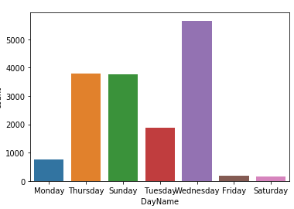
Multivariate Analysis from New Features (To better understand Public_Holiday)
Year – 2018 had more holidays than 2019.
Month – Months 4 , 5 – April and May had most Public_Holiday
Followed by year start month and year end (January and December)
Verified by WeekNumber Variable.
Day – To Summarize better , that which days of month had common holidays ,
Start of month – day 1 had most public_holiday
Followed by month end dates – 25-28
DayofWeek – Mid week specially had most holidays –
Wed and Thursday
Followed by Sunday
Month

Slide 19
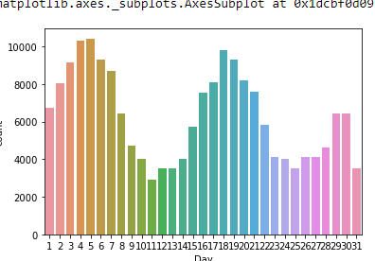
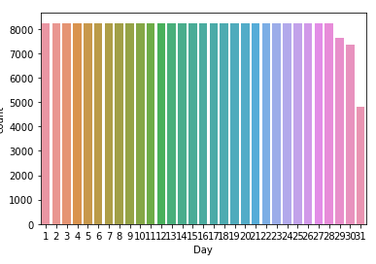
Multivariate Analysis from New Features (For Short and Long Promotion Variable)
Short Promotion --
Day – An interesting pattern is followed throughout the month.
Short_Promotion is active for consecutive 5 days
Followed by no Short_promotion for straight 9 days.
Long Promotion --
Day – Constant pattern being followed.
Long_Promotion is Active for Consecutive 28 days
Followed by 3 days of no promotion.
Short
Long

Slide 20
Some New Features (For User_traffic)
Interesting Point --
No short Promotion day overlapped with Long Promotion day
Verified by making new feature of dividing Short And Long Promotion values
No new feature value came out to be 1 which was only possible if short and long were both 1
Grouped by columns & added aggregated user_traffic in both train and test:
Grouped by columns :
Course ID and Month for User Traffic mean values. – To understand traffic for particular course on monthly basis.
Course Doman , Long_Promotion and Month – To understand monthly trend for Courses with promotions
Course Id , Short Promotion and Public Holiday for User_traffic Mean

Slide 21
Model Selection (Steps taken in the process)
Pre-Processing
Removed Null Values of Competition Metric by replacing with median values.
Since Null values were only 3%
Encoding –
Frequency Encoding
Course_Id , Since it is unique , so for Observing the pattern , number of occurance of frequency of course_id had to be captured.
Month , WeekNumber , Day , DayName
Dummy Variables
Course Domain
Label Encoder –
Course_Type

Slide 23
Linear Regression
Significant features from Backward feature selection
Model performance negligible effect and coefficient are near true values

